Slide 1
The National Weather Service
Helping to Build a Weather-Ready Nation

Slide 2
El Paso County
Flood and Fire Community Preparedness
Jennifer Stark
Meteorologist in Charge
National Weather Service Pueblo, CO

Slide 3
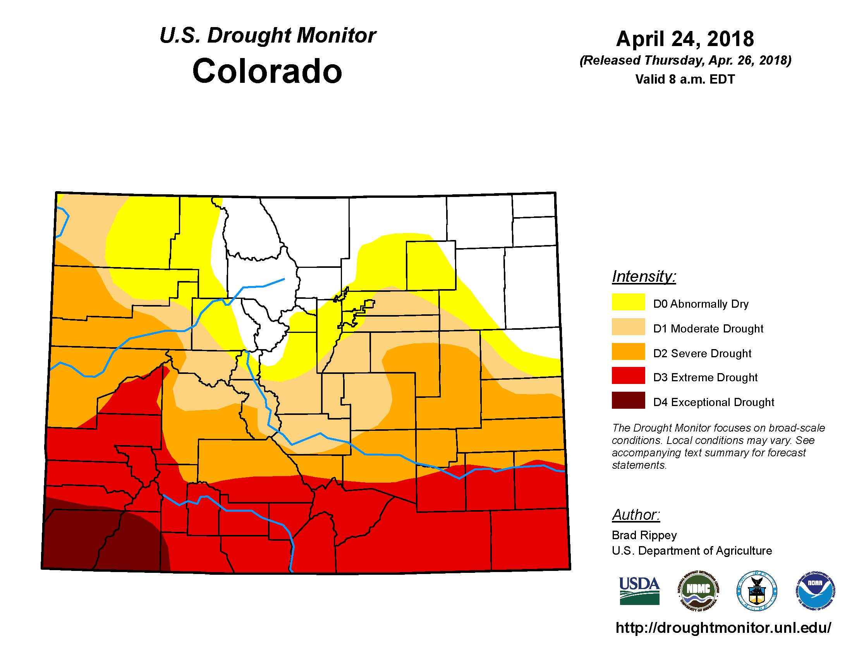
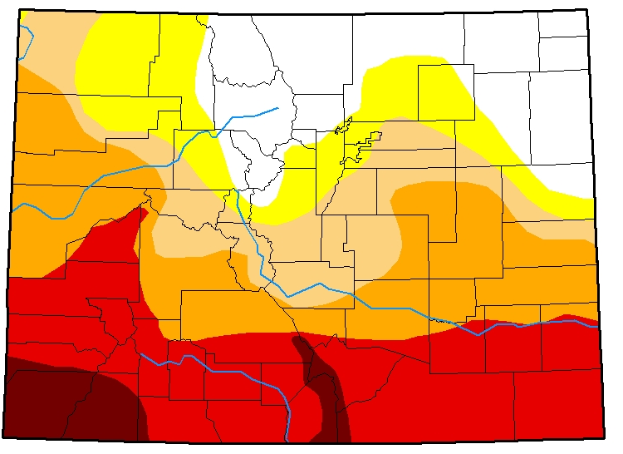
Drought…
May 1, 2018

Slide 4
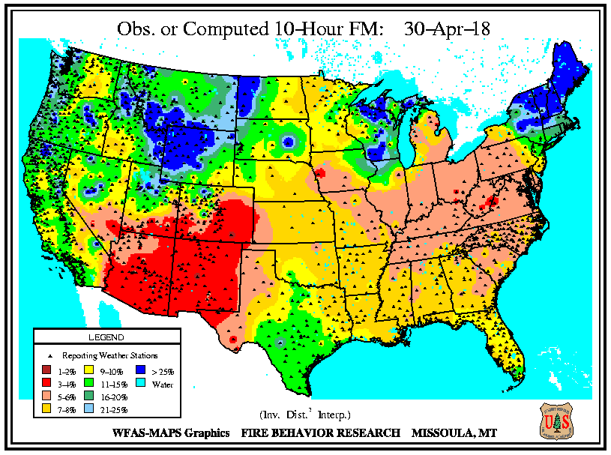
Fuels Moisture (10 Hour)

Slide 5
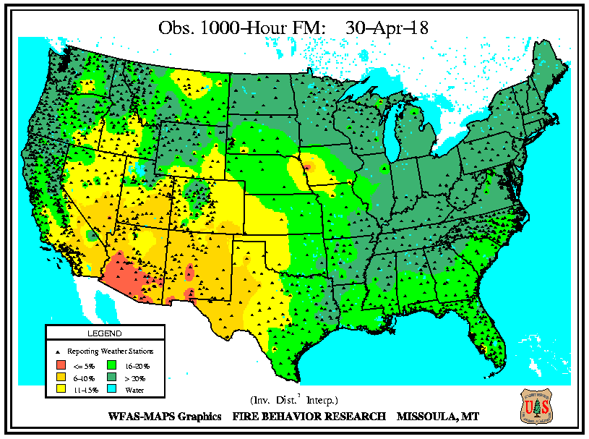
Fuel Moisture (1000 Hour)

Slide 6
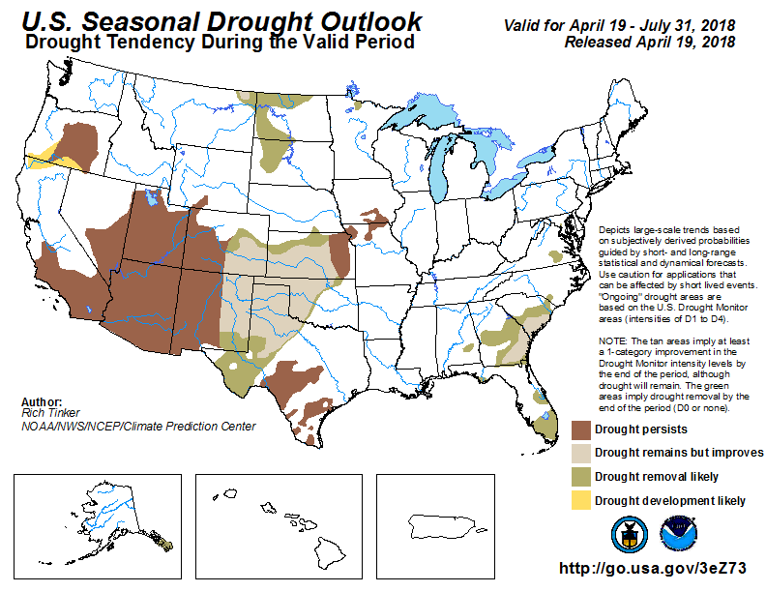
Drought…

Slide 7
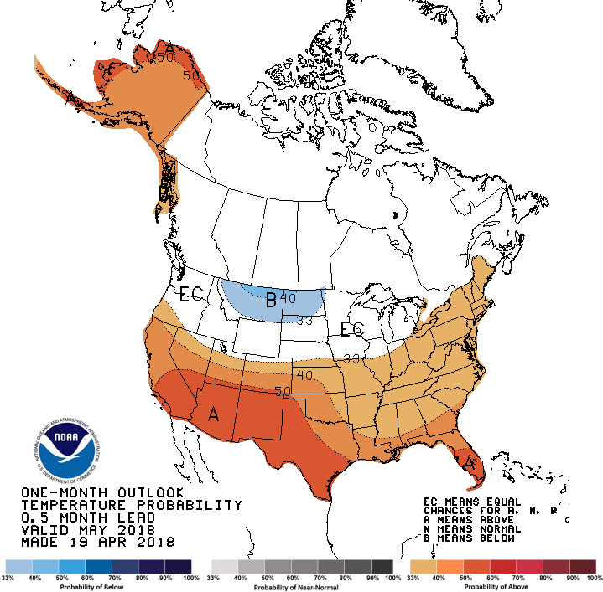
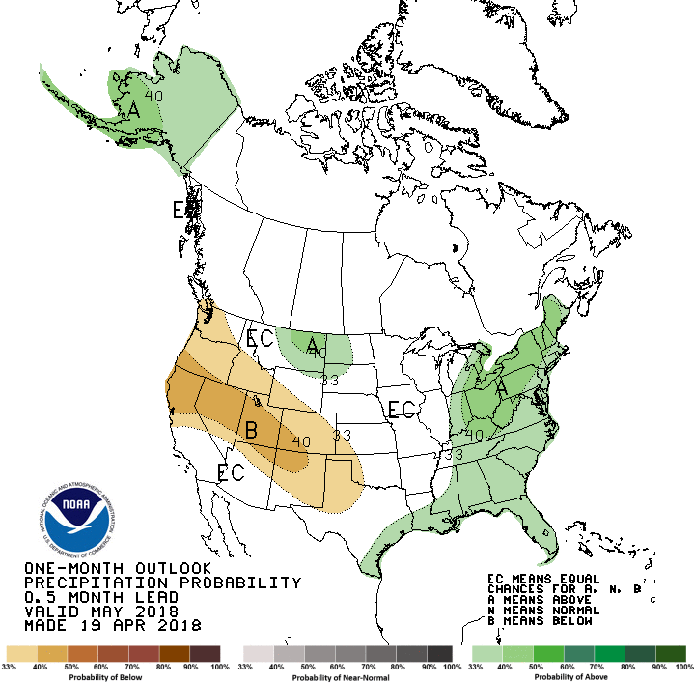
1 Month Outlook - May
Temperature
Precipitation

Slide 8
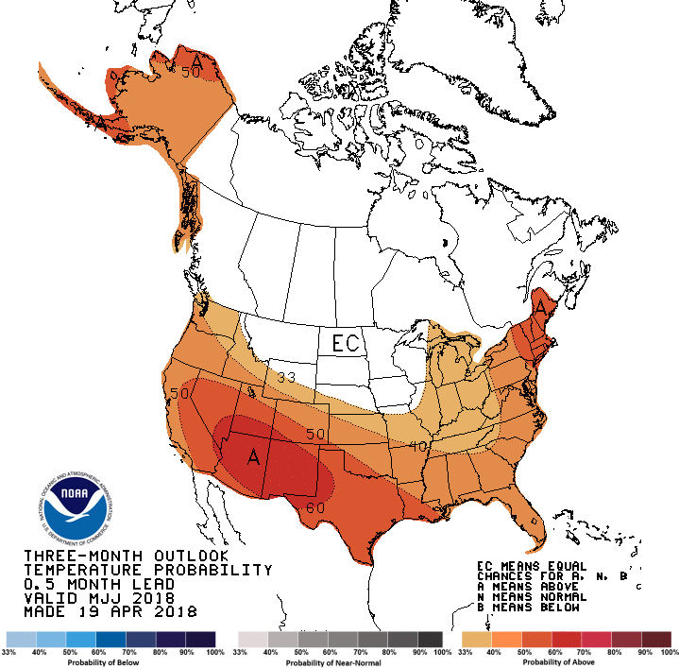
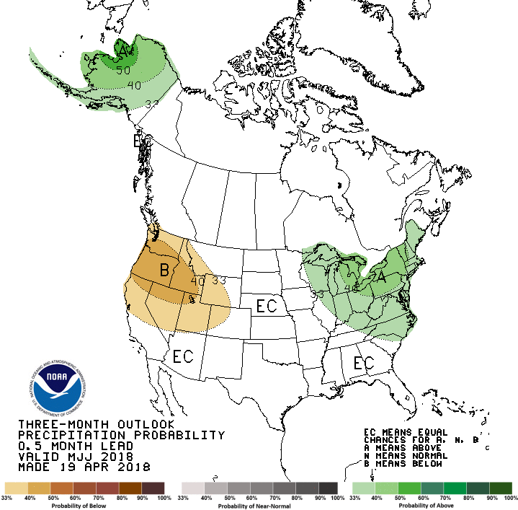
Outlook for May, June, July
Temperature
Precipitation

Slide 9
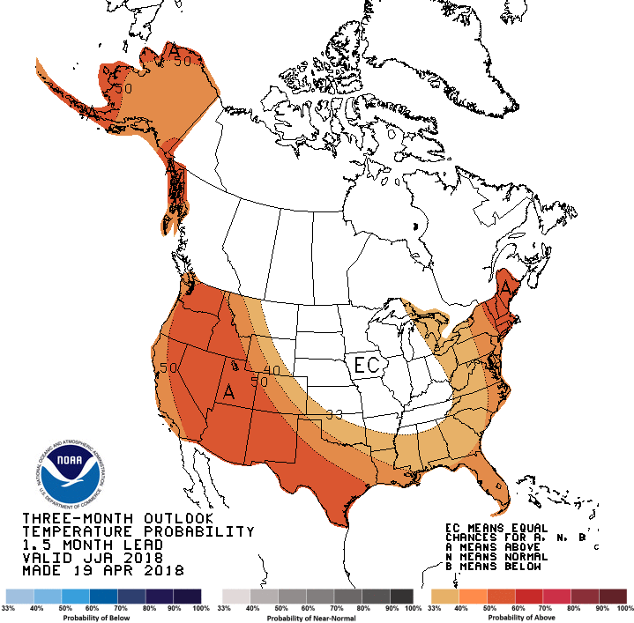
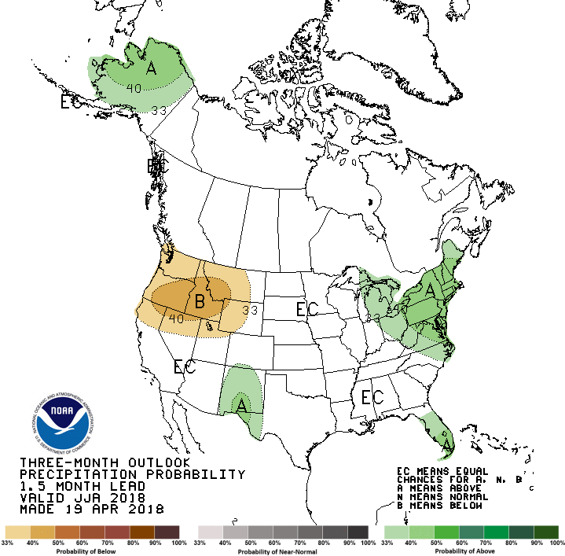
Outlook for June, July, August
Temperature
Precipitation

Slide 10
Watch vs. Warning
A Watch means….GET READY
Conditions are or will be favorable for a storm, a flood, or fire weather to happen but it is not happening right now.
Have a plan. Be aware of your surroundings.
Protect your property.
A Warning means….GO….Danger is here!
A storm, a flood, or fire weather is happening now or is expected to happen shortly.
Execute your plan. Take actions to protect your life.

Slide 11
Fire Weather Watch/Red Flag Warning
The NWS issues Fire Weather Watches and Red Flag Warnings for the following conditions:
Fuels...Critically dry as reported by Land Managers
Thunderstorms... with lightning but little if any rain
Wind...25 mph sustained or gusting > 25 mph
Relative Humidities...15% or less
Any combination...weather and fire danger that would create a critical fire control situation or wildfire outbreak
We try to give 24 to 48 hours of notice with a watch and then upgrade to a warning.
Many days when weather conditions approach the above, but watches and warnings may not be issued because of fuels or weather criteria will not be met.

Slide 12
Flash Flood Products
Flash Flood Watch
Generally issued 12 to 24 hours in advance of flooding
Urban and Small Stream Flood Advisory
means that nuisance flooding is expected, but not normally life threatening. Pay attention to your surroundings, a warning may be issued at any time.
Flash Flood Warning
Means flooding is imminent or already occurring

Slide 13
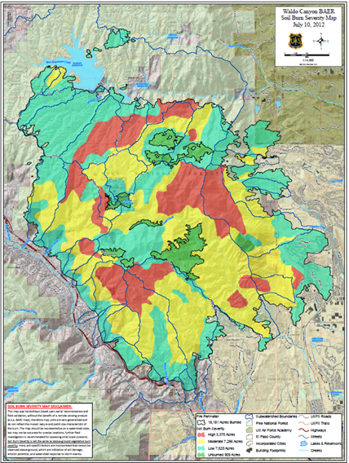
Waldo Canyon
Current Thresholds for Warning
(Slight Change from 2017)
1.50 inches in an hour
(radar estimates)
2.50 inches/hour
Sustained Preipitation Rate
(15-20 minutes)

Slide 14
Waldo Canyon - Recovery??
Year | Daily Precip. Total | Precip. Rate | Flow at Fountain Crk. Gage Results
2013 | 0.75- 1.50” | ??? | 1,450 cfs Manitou Springs Flood
2015 | 1.50- 2.0” | 4.28”/ hour | 222 cfs Autism Ctr. Flood Manitou Springs stormwater back up
2017 | 1.0-1.5” 1.22” in Williams Canyon | 1.44”/ hour | 627 cfs No significant flooding

Slide 15
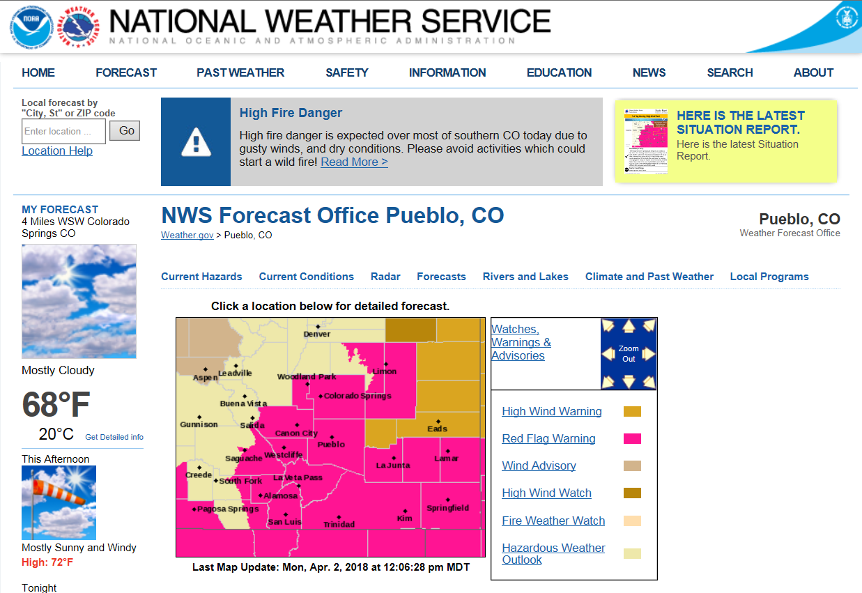
weather.gov/pub

